Slide 1

Enhancing Search Engine Relevance for Video Subtitles
Thota Chandra Sekhar
B Ganga Vignesh

Slide 2

Introduction :
In today's digital era, search engines are vital for accessing relevant content efficiently.
This project focuses on enhancing search engine relevance specifically for video subtitles, aiming to improve user experience and content accessibility.
By leveraging natural language processing and machine learning techniques, our objective is to develop an advanced search algorithm that delivers accurate and meaningful results for video subtitle queries.

Slide 3
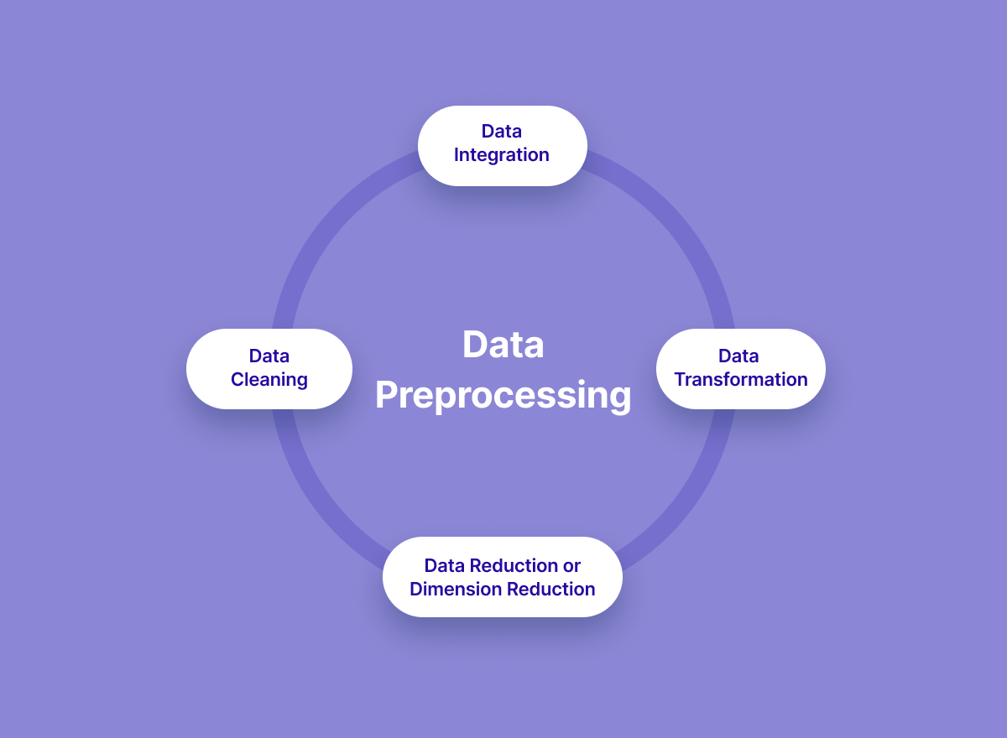
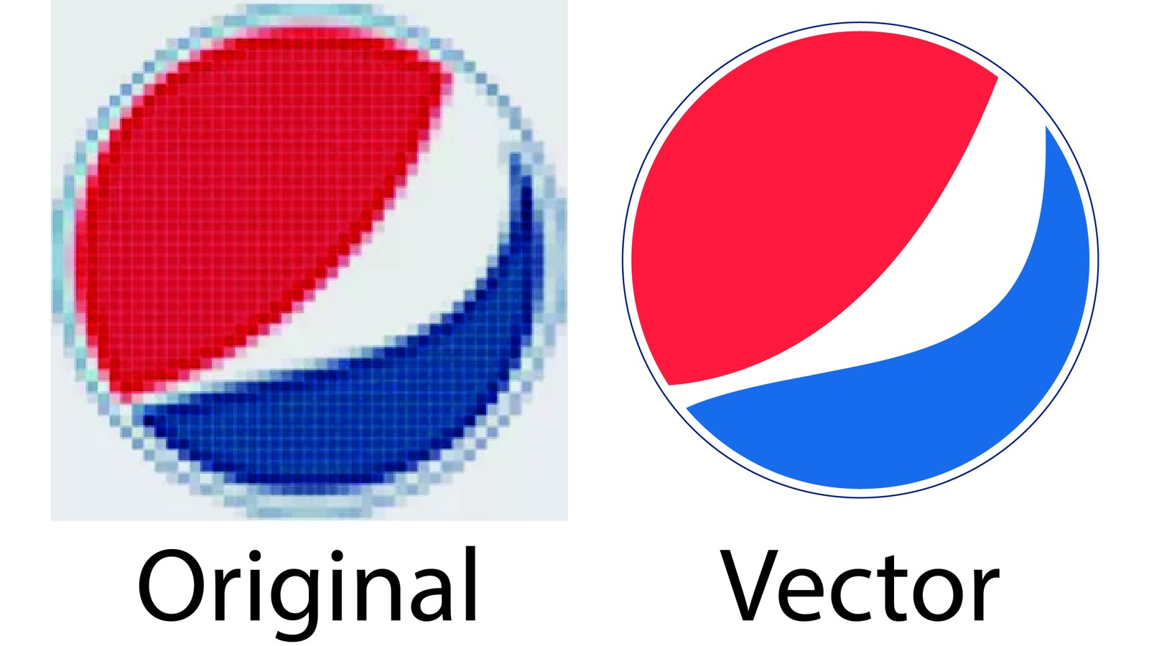
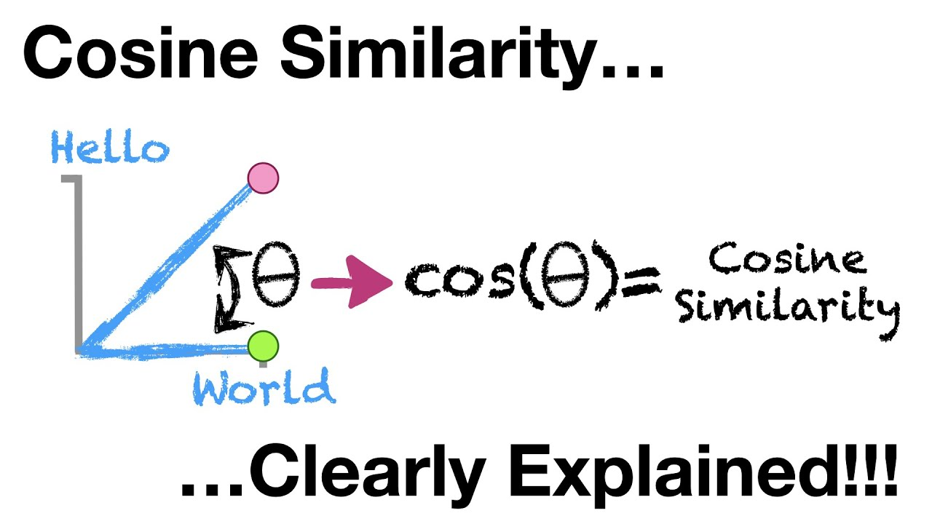

Core Logic :
Data Preprocessing : Clean text data (e.g., remove timestamps) crucial for vectorization.
Vectorization : Vectorize subtitle documents and user queries.
Cosine Similarity : Calculate cosine similarity between document and query vectors.
Result Retrieval : Return most similar documents based on similarity scores.

Slide 4
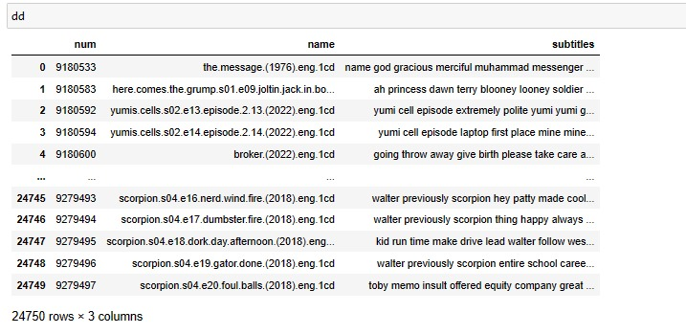
Data Processing :
Read data from database tables using Python.
Handle ZIP files with Latin-1 encoding.
Data Operations:
Clean data: remove timestamps, leading characters, symbols, numbers, and tags.
Select 30% of the data.
Result:
Show cleaned and processed data.

Slide 5
BOW/TFIDF for searching keywords. Sentence transformers based on BERT for semantic search
Text Vector Generation :.
Document Chunkier :Handling large documents, Mitigating information loss with overlapping windows.
Embedding Storage in Chroma DB :Efficient storage and retrieval.

Slide 6
Retrieving Documents :
Take the user's search query.
Preprocess the query (if required).
Create query embedding.
Using cosine distance, calculate the similarity score between embeddings of documents and user search query embedding.
These cosine similarity scores will help in returning the most relevant candidate documents as per user’s search query.

Slide 7
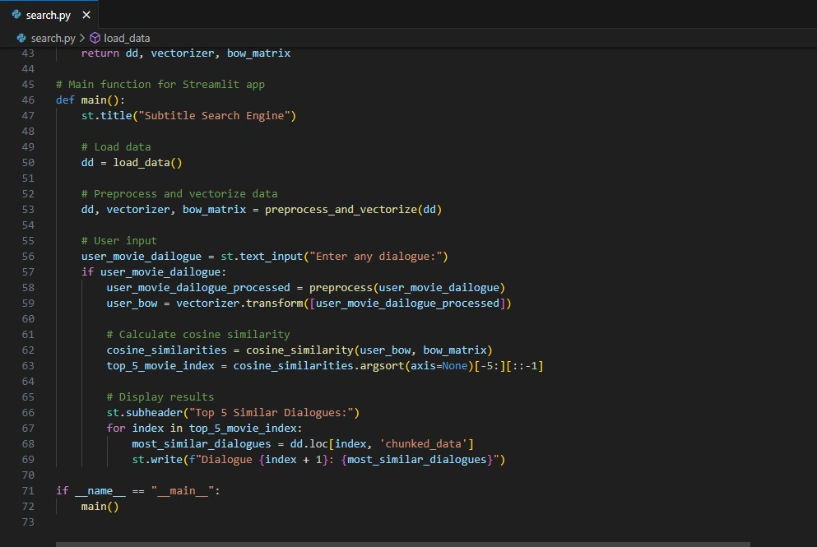
The code is for a Streamlit application that serves as a search engine for movie subtitles. It processes user search queries, loads data from a CSV file into a Pandas Data Frame, and shows results using HTML templates styled with CSS.

Slide 8
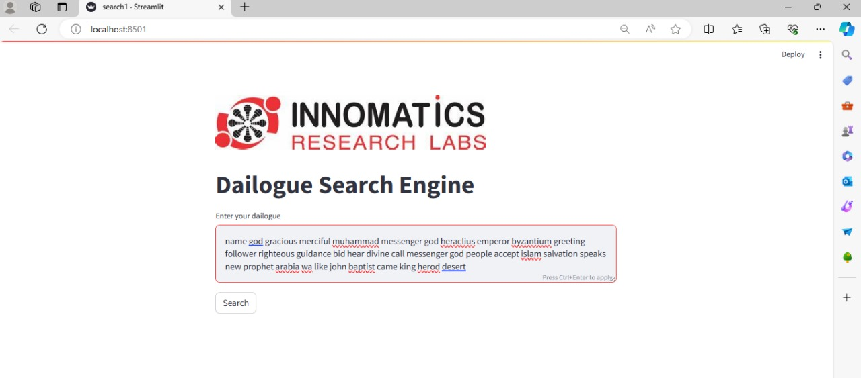
Output Result :
The code generates a web application that allows users to look for movie subtitles. The outcomes are shown on a page with a particular color scheme and layout.

Slide 9
Conclusion :
Summary of project objectives and methodology.
Impact : Improved search relevance for video subtitles.
Future Directions : Potential enhancements or extensions.
The goal of this research is to improve video subtitle search engine relevance by utilizing cutting edge methods such as efficient document processing and semantic understanding.

Slide 10


